Slide 1
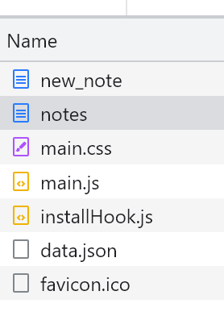
Browser
Server
The user types the “note” in the text field, then submits the form. The browser sends user input to the server
POST https://studies.cs.helsinki.fi/exampleapp/new_note
This is a URL re-direct, which causes the browser to perform a new request to the notes address
HTML document
Status Code: 302
The script on the server adds the note as an object (content and date) to an array of objects (notes)
GET https://studies.cs.Helsinki.fi/exampleapp/notes
HTML document
Status Code: 200
GET https://studies.cs.Helsinki.fi/exampleapp/main.css
The style sheet
Status Code: 200
GET https://studies.cs.Helsinki.fi/exampleapp/main.js
The JavaScript file
Status Code: 200
The browser starts executing the JavaScript code that fetches the JSON data from the server
GET https://studies.cs.Helsinki.fi/exampleapp/data.json
JSON data
Status Code: 200
{“content”: “note 1”, “date”: “2023-4-21”}, {“content”: “note 2”, “date”: “2023-4-23”}, …
The browser executes the callback function that renders the updated notes
https://studies.cs.helsinki.fi/favicon.ico
Favicon [Image]
Status Code: 200

